Slide 1
Lead Scoring Case Study
Pranathi R
Ankit Singh
Mrinmoy Choudhury

Slide 2
PROBLEM STATEMENT
X Education sells online courses to industry professionals. X Education gets a lot of leads, its lead conversion rate is poor. To make this process more efficient, the company want to identify the most potential leads. They want to build a Model which identifies the hot leads. Deployment of the model for the future use. If they successfully identify this set of leads by the model, the lead conversion rate should go up as the sales team will now be focusing more on communicating with the potential leads rather than making calls to everyone.

Slide 3
METHODOLOGY
Data cleaning and data manipulation.
EDA
Feature Scaling & Dummy Variables and encoding of the data.
Classification technique: logistic regression used for the model making and prediction.
Validation of the model.
Model presentation.
Conclusions and recommendations.

Slide 4
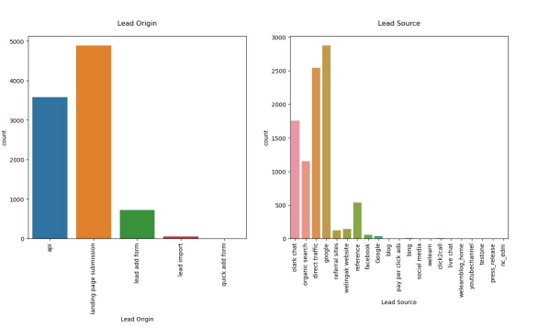
EDA

Slide 5
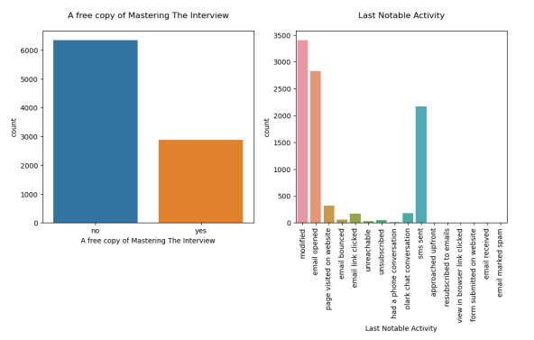

Slide 6
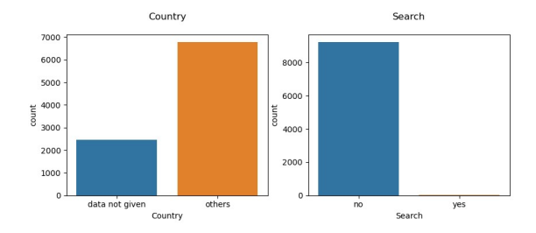
VARIABLE RELATION

Slide 7
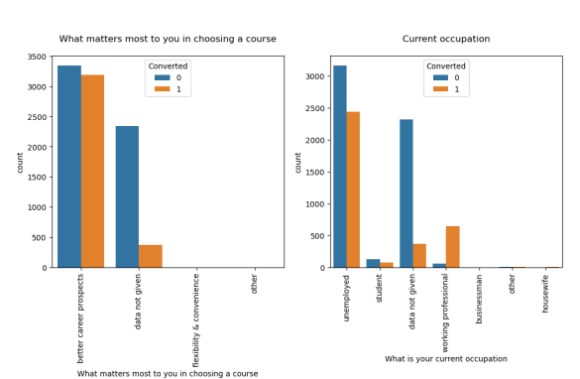

Slide 8
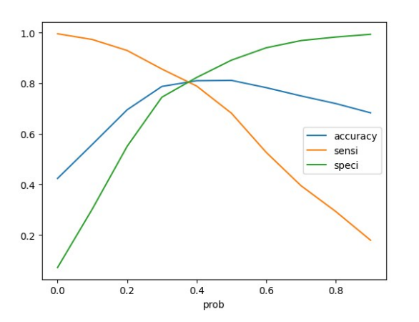
ROC CURVE

Slide 9
CONCLUSION
Variable that matter the most in potential buyers are :
Total number of visits.
Current occupation of the lead.
Total time spend on the Website
What was the source of the lead. If lead is direct traffic then there is more possibility that lead would join to the course.

Slide 10
THANK YOU

